Slide 1



Metamaterial acoustic lenses (for dummies)
Simulation Techniques IN ACOUSTICS
Marcelo Argotti Gomez

Slide 2
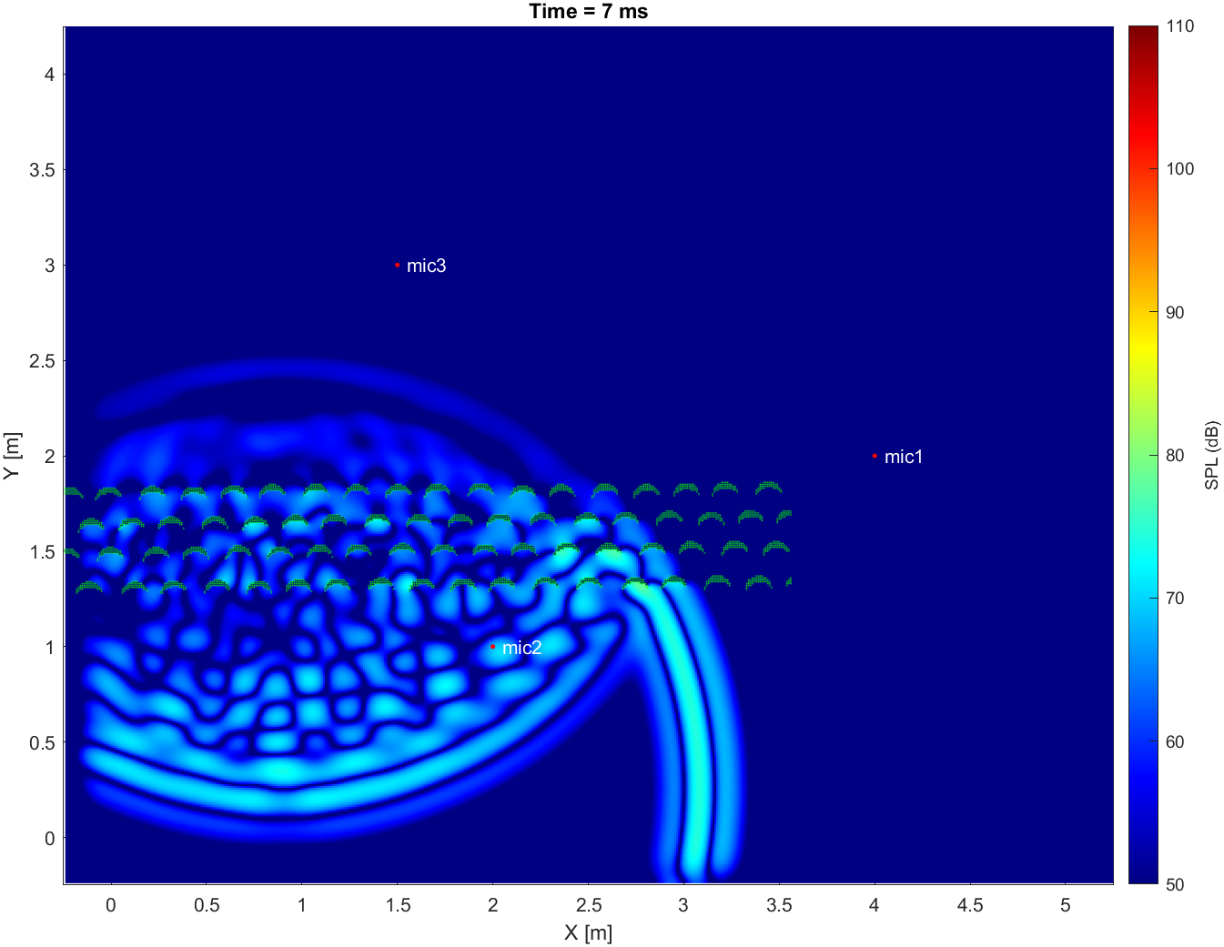
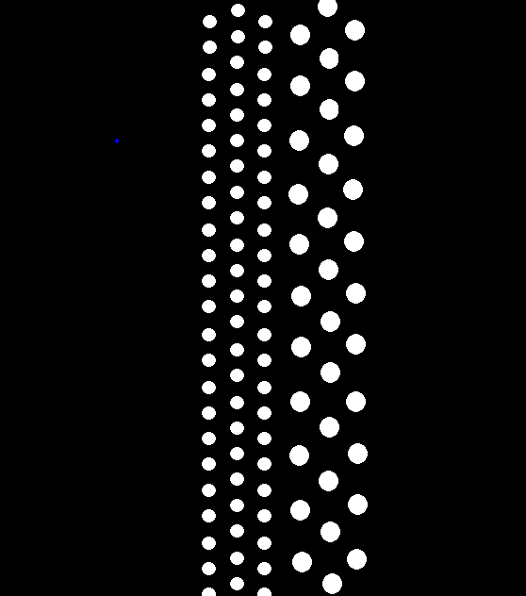
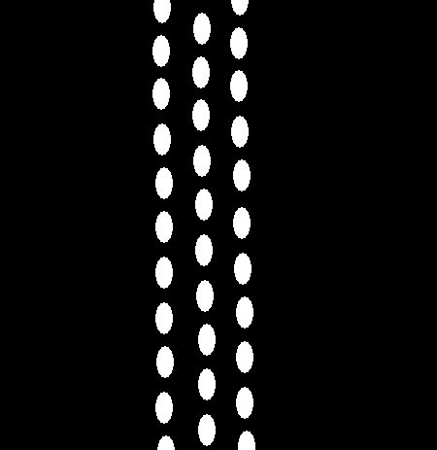
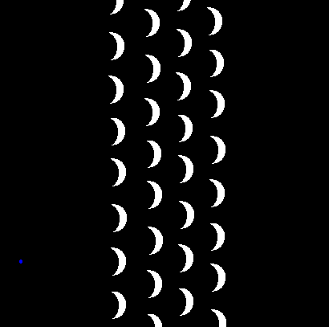
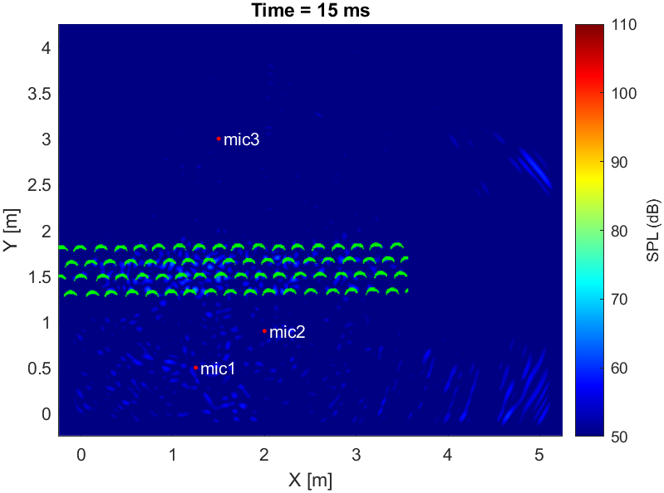
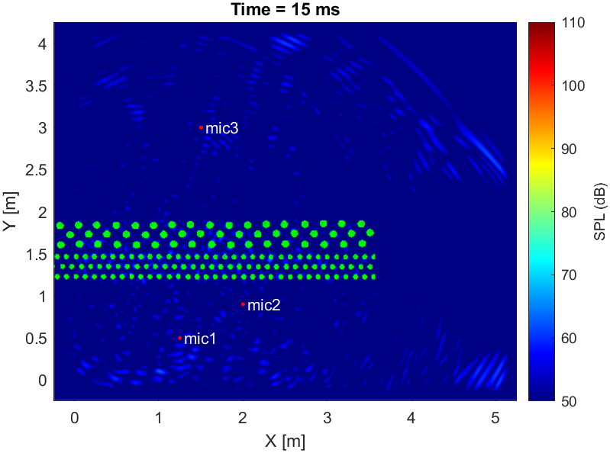
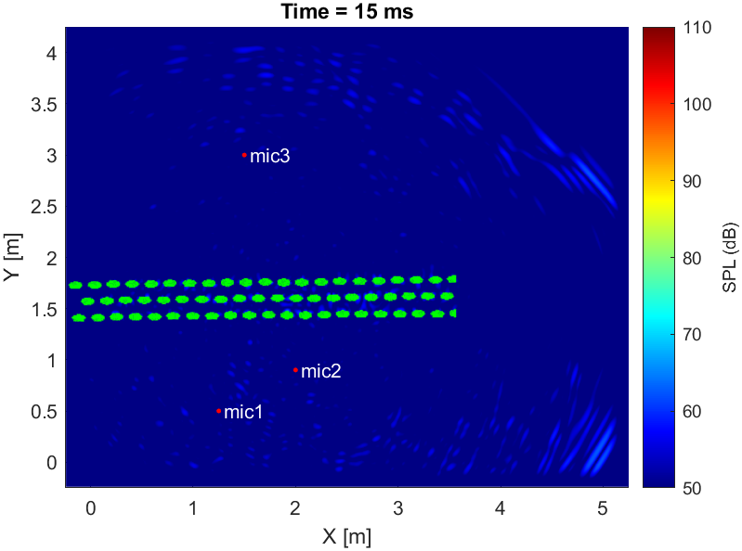
Overview

Slide 3
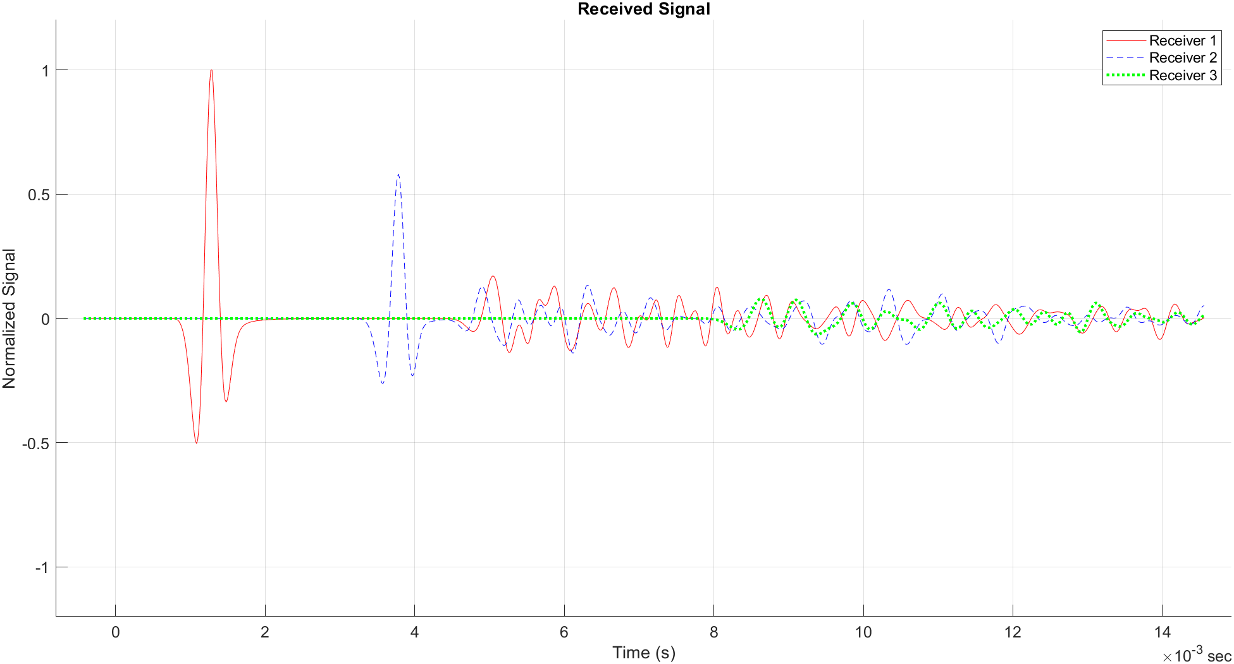
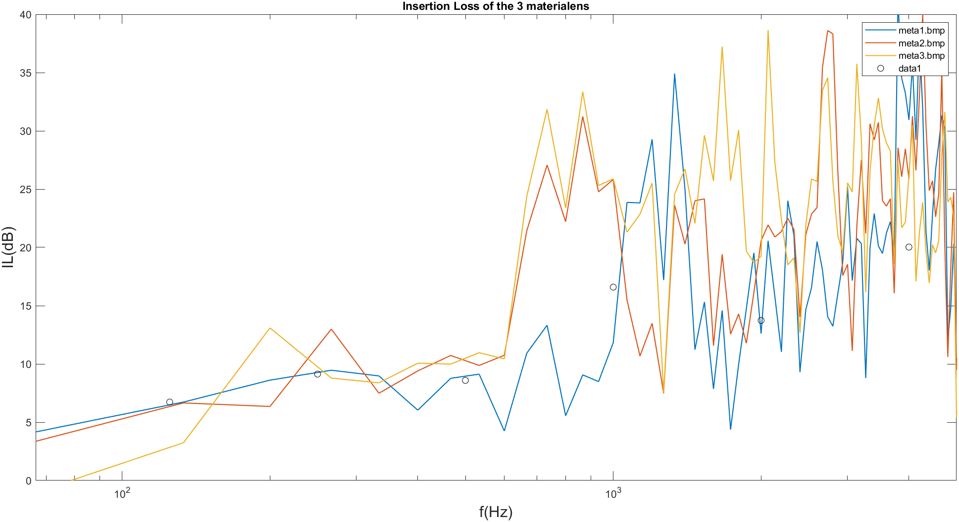
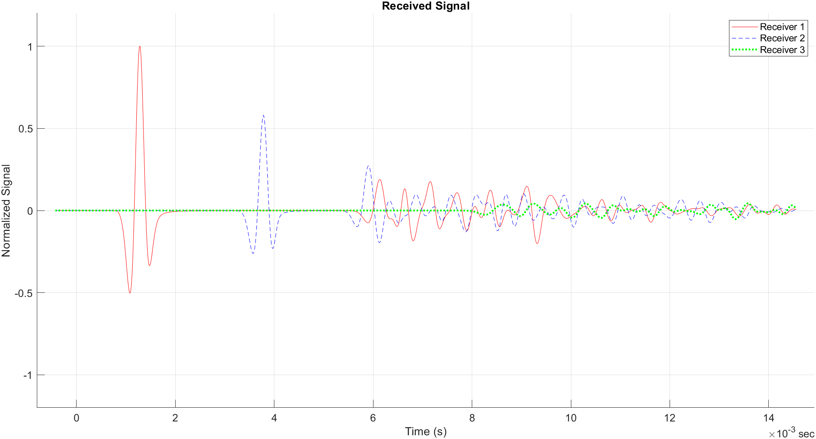
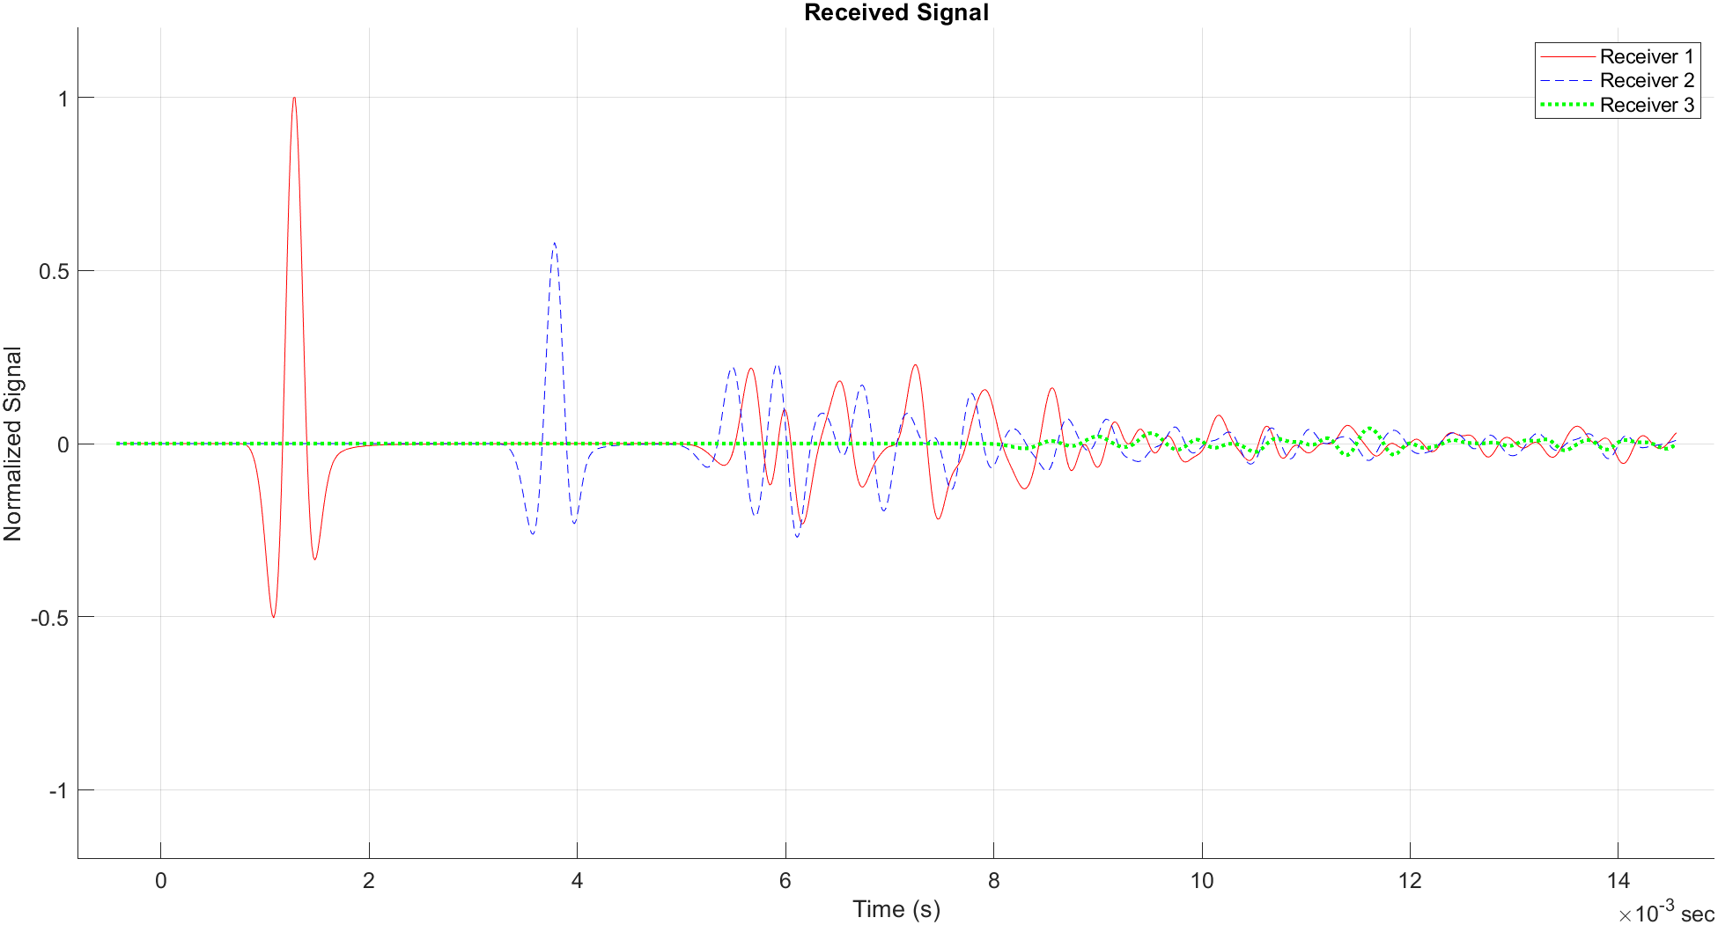
Results
meta1
meta2
meta3

Slide 4
Conclusions and final remarks
The specific application of an acoustic lens will determine the most appropriate design and material selection. In the present case, a far-field acoustic lens has been achieved.
Setting boundary conditions > 0 to the metamaterial lens will affect the refractive index of the lens media, hence the speed of sound will change as it travels through the lens.
Implement GRIN (gradient index) to test if it is possible to achieve focusing around the center frequency of the wavelet.

Slide 5
Bibliography
Alagoz, Baris Baykant, and Serkan Alagoz. “Towards Earthquake Shields: A Numerical Investigation of Earthquake Shielding with Seismic Crystals.” Open Journal of Acoustics, vol. 01, no. 03, Scientific Research Publishing, Inc., 2011, pp. 63–69, doi:10.4236/oja.2011.13008.
J. Redondo, “Block 2: Finite difference time domain method (FDTD), UPV.” Lecture slides, 2024.

